Slide 1
BOOTSTRAP - 4.0 RESPONSIVE web design (rwd)
R.Rajadevi AP/IT, KEC

Slide 2
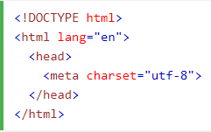
To start with……
Step1: Add HTML5 doc
Step2: responsive mobile app
width=device-width
sets the width of the page to follow the screen-width of the device (which will vary depending on the device)
initial-scale=1
sets the initial zoom level when the page is first loaded by the browser.

Slide 3
Responsive Web Design(RWD)
RWD is about creating web sites which automatically adjust themselves to look good on all devices, from small phones to large desktops
It provides an optimal viewing experience with minimum resizing across various devices
HTML and CSS is used to resize, hide, shrink, enlarge or move the content to render a good web page on any screen of any standard size
RWD is not a program or a JavaScript

Slide 4
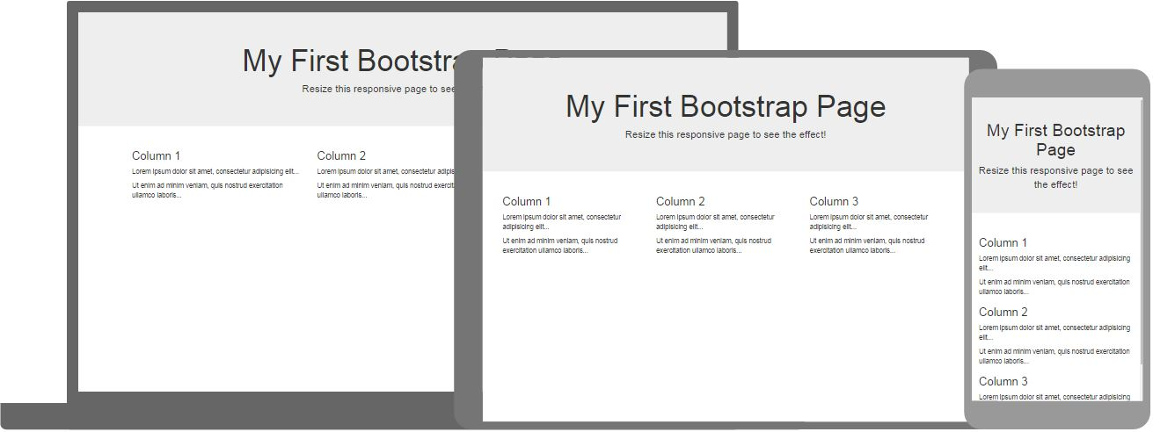
Outline
Introduction to Bootstrap

Slide 5

Responsive Web Design(RWD)

Slide 6
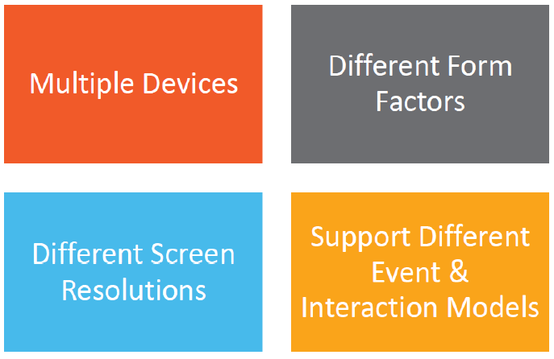
Need for Current Challenge

Slide 7
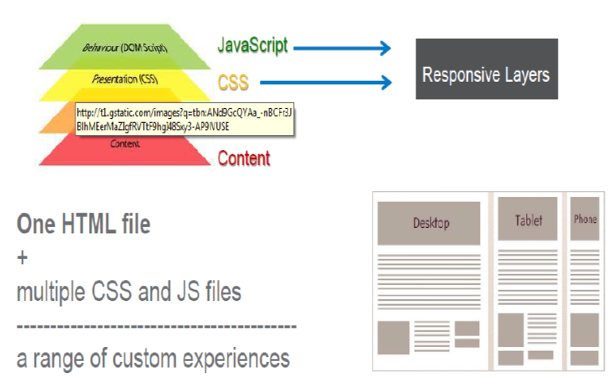
RWD- Separation of content and Presentation

Slide 8
RWD
Viewport is the user's visible area of web page
It varies with devices and will larger on a computer screen compared to mobile phones
Few core concepts of RWD:
Fluid layout
Web page layout was designed based on the size of viewport
Flexible images
Responsive images to adapt to the size of viewport
Media Queries
Selectively applying CSS for styling on small and large screens

Slide 9
What is Bootstrap?
Bootstrap is a free front-end framework (HTML and CSS) for faster and easier web development
Bootstrap is famous for being developed with components that have the ability to design the responsive designs
Responsive Design is about using CSS and HTML to resize, hide, shrink, enlarge, or move the content to make it look good on any screen
Responsive Design allow your page works for computer, tablets and mobile phones

Slide 10
Features
Powerful 12 column fluid grid system
Customizable mobile first grid with 4 major breakpoints (480px , 768px, 992px and 1200px)
Grid configs : Nested, Offset and Column ordering
Typography classes like Address , Block quotes, Lists etc.
Stylish tables, forms and buttons
Responsive images
Visibility classes
Bootstrap makes use of the LESS(LEaner cSS) framework, which is a CsS preprocessor, and makesthe CSS code leaner and meaner

Slide 11
Bootstrap 3 vs. Bootstrap 4
Bootstrap 4 is the newest version of Bootstrap; with new components, faster stylesheet and more responsiveness.
Bootstrap 4 supports the latest, stable releases of all major browsers and platforms.
However, Internet Explorer 9 and down is not supported.

Slide 12
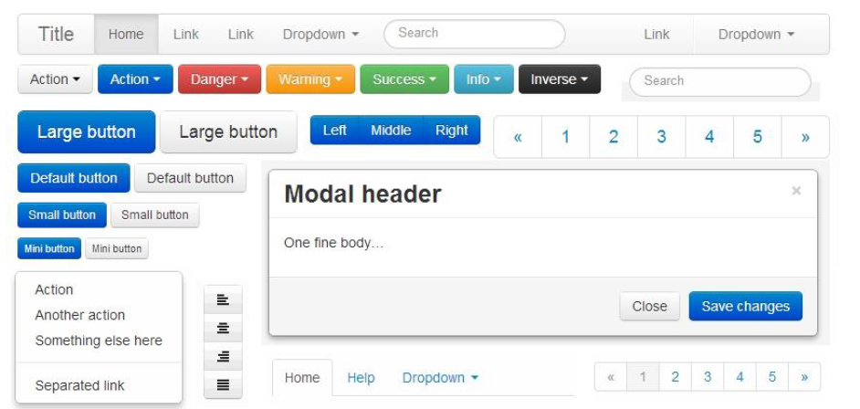
Build in components

Slide 13
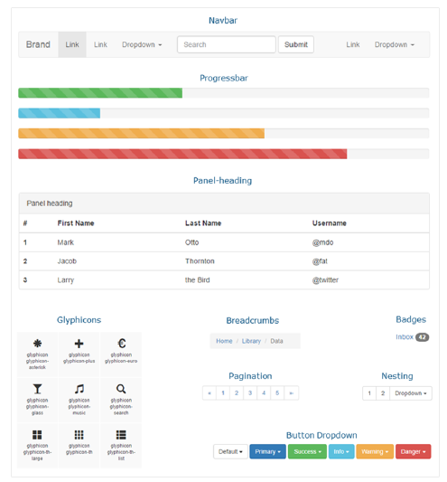
Build in components

Slide 14
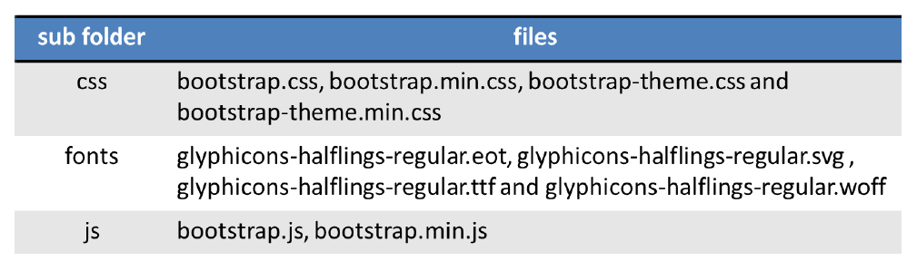
Bootstrap

Slide 15
REFERING BOOTSTRAP
<!DOCTYPE html>
<html lang="en">
<head>
<title>Bootstrap Example</title>
<meta charset="utf-8">
<meta name="viewport" content="width=device-width, initial-scale=1">
<link rel="stylesheet" href="https://maxcdn.bootstrapcdn.com/bootstrap/3.4.1/css/bootstrap.min.css">
</head>
<body>

Slide 16
Bootstrap - Grid basics – Tables –Images - Button - list - Drop down - Navs - Nav Bar - Forms-Input – Input Groups

Slide 17
Grid Classes
.col- (extra small devices - screen width less than 576px)
.col-sm- (small devices - screen width equal to or greater than 576px)
.col-md- (medium devices - screen width equal to or greater than 768px)
.col-lg- (large devices - screen width equal to or greater than 992px)
.col-xl- (xlarge devices - screen width equal to or greater than 1200px)

Slide 18
Grid System
The grid system is responsive, and the columns will re-arrange automatically depending on the screen size
Bootstrap's grid system is built with flexbox and allows up to 12 columns across the page.
Use all 12 columns individually, you can group the columns together to create wider columns:
span 1 | span 1 | span 1 | span 1 | span 1 | span 1 | span 1 | span 1 | span 1 | span 1 | span 1 | span 1
span 4 |  |  |  | span 4 |  |  |  | span 4
span 4 |  |  |  | span 8
span 6 |  |  |  |  |  | span 6
span 12

Slide 19
Grid System
Bootstrap provides a responsive, mobile first fluid grid system that appropriately scales up to 12columns based on the size of device or viewport.
It includes built-in classes for layout options and powerful mixins for semantic layouts
Mobile First Strategy
Content
Determine what is most important.
Layout
Design to smaller widths first.
Base CSS address mobile first; media queries address for tablet, desktops.
Progressive Enhancement
Add elements as screen size increases.

Slide 20
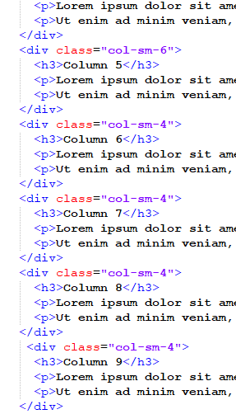
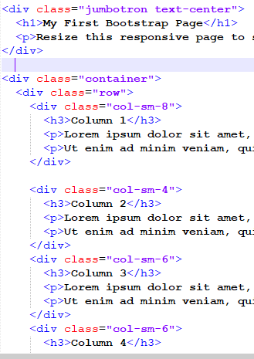
Col-sm-1
Remaining all
(Column:10-21-12col)
<div class="col-sm-1">
-----Contents-----
</div>

Slide 21
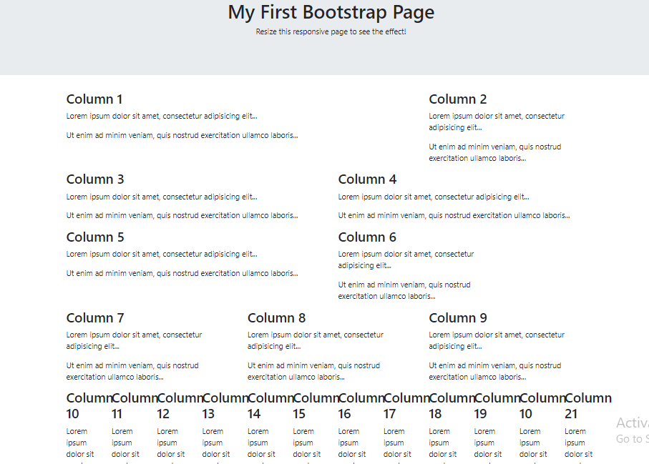
8
4
6
6
6
4
4
4
4
Each 1
Total-12

Slide 22
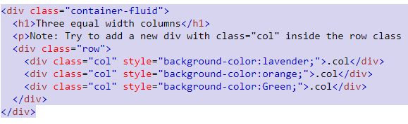
Equal width columns- Resize

Slide 23
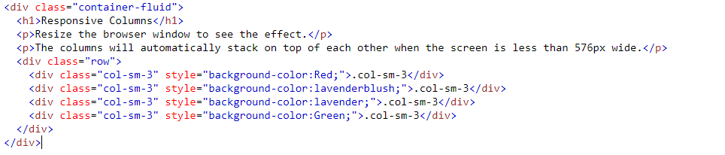
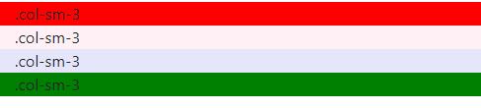
Responsive Columns
Resize-Automatically stack on the top

Slide 24
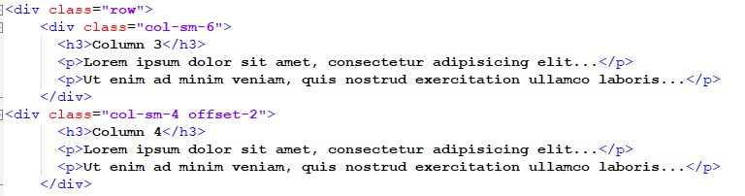
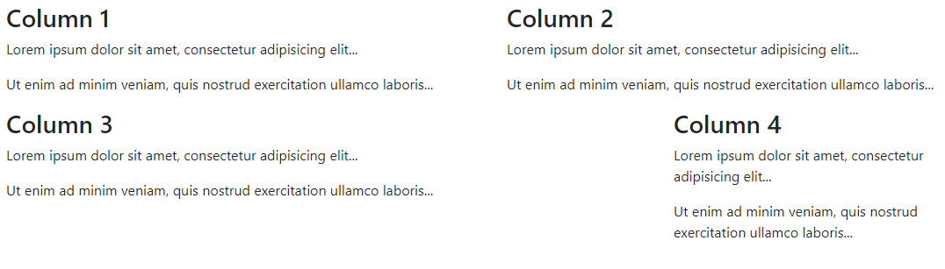
OFFSET-2

Slide 25
Mixed Grids

Slide 26
Nesting Columns

Slide 27

Containers
a containing element to wrap site contents
Container classes
.Container
provides a responsive fixed width container
.Container-fluid
provides a full width container, spanning the entire width of the viewport

Slide 28
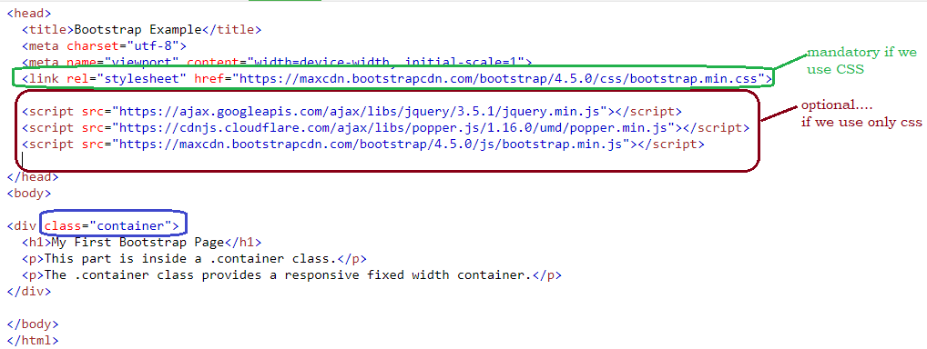
.Container class-Example

Slide 29
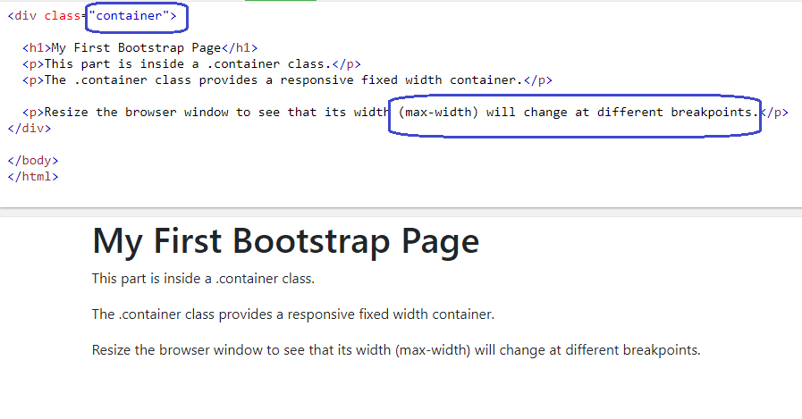
.Container class-Example
Execute and notice the change at different points when changing the browser size

Slide 30
Container padding
Padding – width around the content
Default:
Left & right – 15px
Top & bottom – no padding
Padding classes
.pt-3 means "add a top padding of 16px“
.pt-4 ---- next level…..

Slide 31

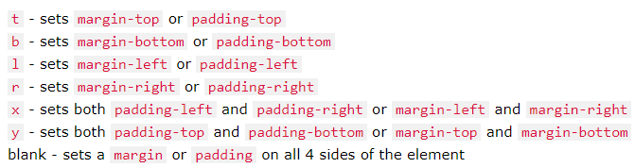
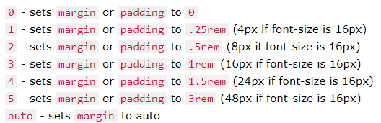
BS-Utilities-Property, sides & size
Property:
Sides:
Size:

Slide 32
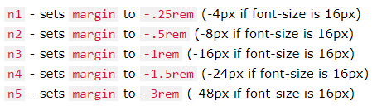
BS-Utilities-Property, sides & size
Negative Margins:

Slide 33
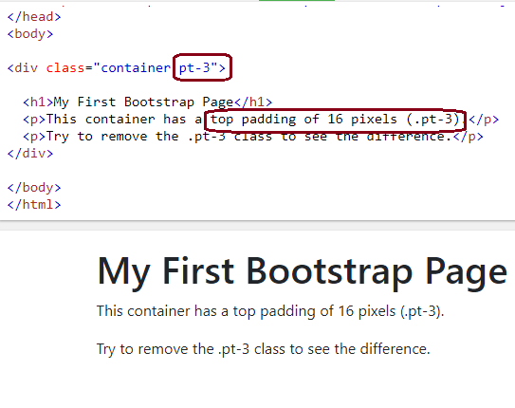
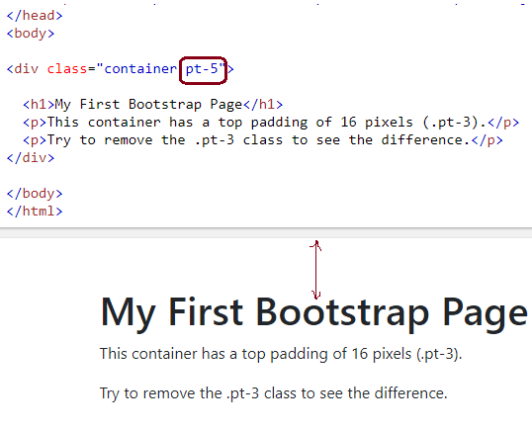
Container padding (.pt)

Slide 34
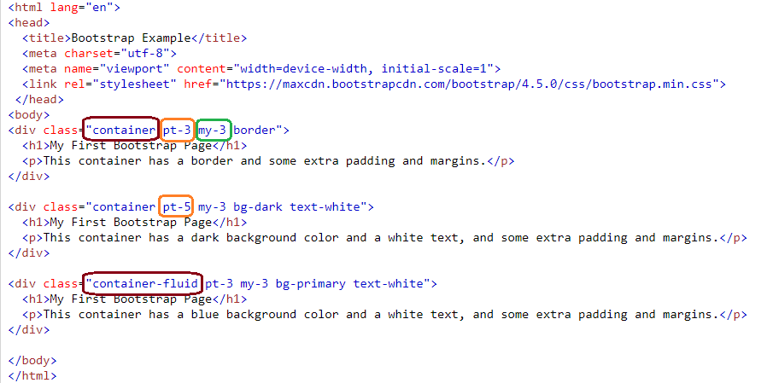
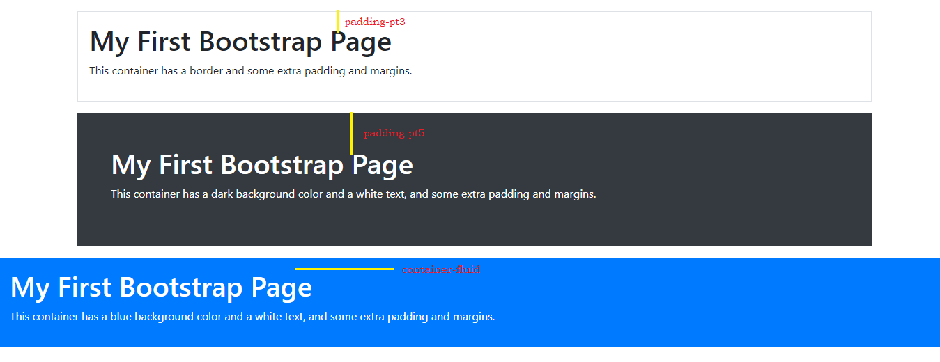

Slide 35
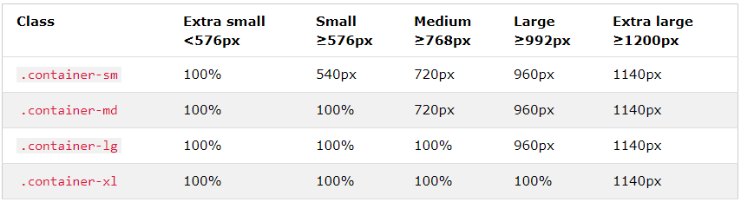
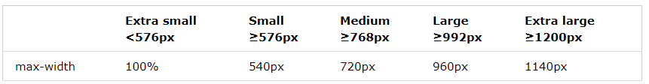
Responsive Containers
The max-width of the container will change on different screen sizes/viewports

Slide 36
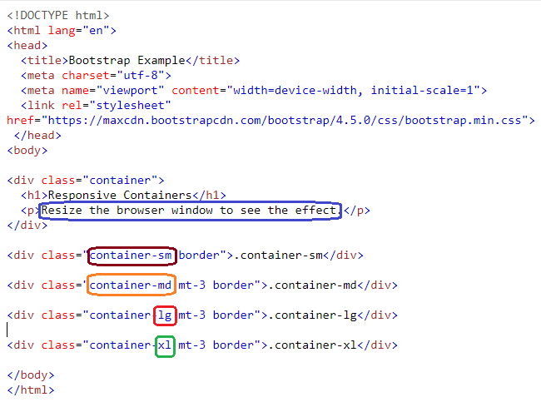
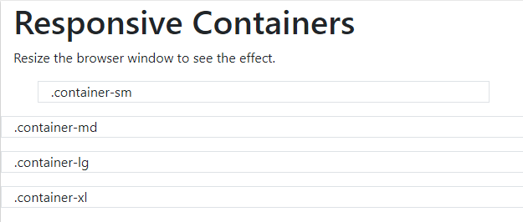
Responsive Containers

Slide 37
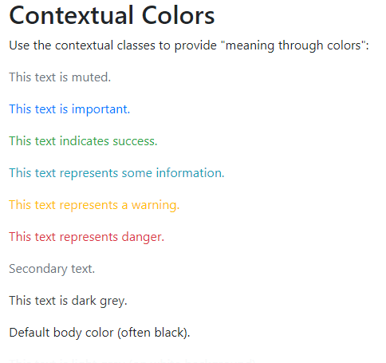
Text Colors
Bootstrap 4 has some contextual classes that can be used to provide "meaning through colors".
The classes for text colors are:
.text-muted
.text-primary
.text-success
.text-info
.text-warning
.text-danger
.text-secondary
.text-white
.text-dark
.text-body (default body color/often black)
.text-light

Slide 38
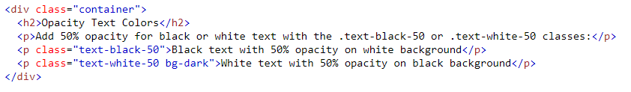
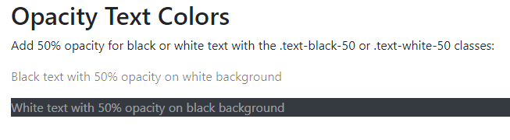
opacity
You can also add 50% opacity for black or white text with the .text-black-50 or .text-white-50 classes:

Slide 39
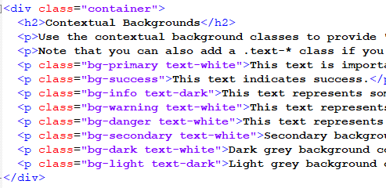
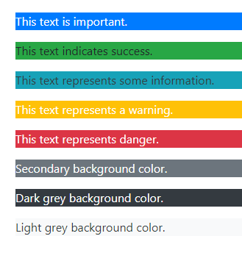
Background Colors
The classes for background colors are:
.bg-primary
.bg-success
.bg-info
.bg-warning
.bg-danger
.bg-secondary
.bg-dark
.bg-light

Slide 41
Tables
A basic Bootstrap 4 table has a light padding and horizontal dividers.
The .table class adds basic styling to a table:
Example
<table class="table">
<table class="table table-bordered">
<table class="table table-striped">
<table class="table table-hover">
<table class="table table-dark">
<table class="table table-borderless">
<table class="table table-dark table-striped">

Slide 42
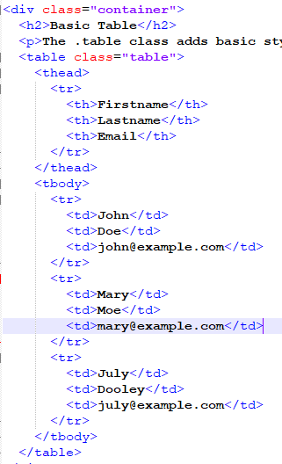
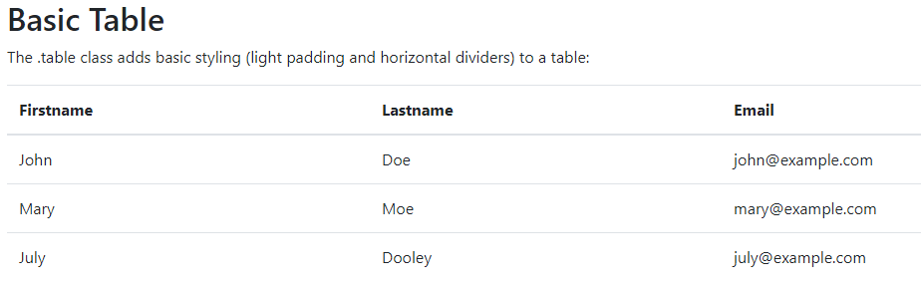
Tables

Slide 43
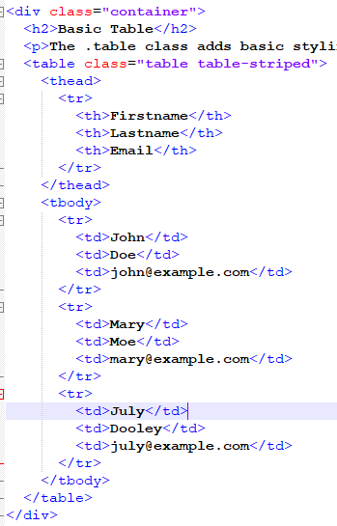
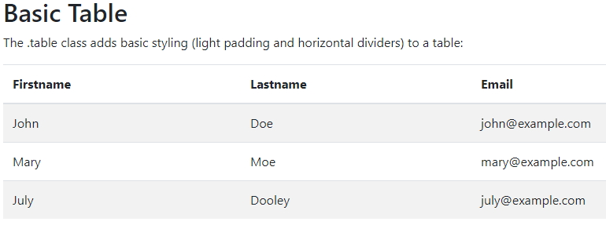
Striped Rows
The .table-striped class adds zebra-stripes to a table:

Slide 44
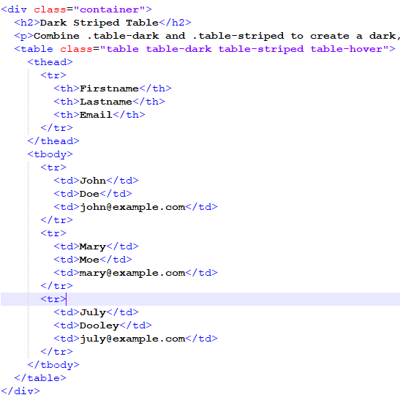
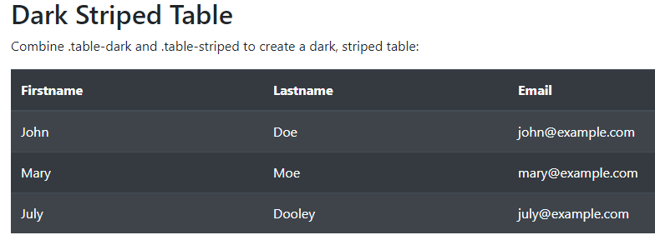
Dark-Striped-hover

Slide 45
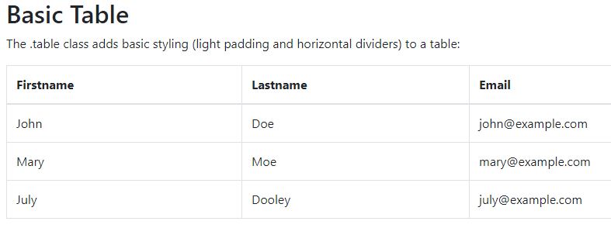
Bordered Table

Slide 46
Contextual Classes
Class | Description
.table-primary | Blue: Indicates an important action
.table-success | Green: Indicates a successful or positive action
.table-danger | Red: Indicates a dangerous or potentially negative action
.table-info | Light blue: Indicates a neutral informative change or action
.table-warning | Orange: Indicates a warning that might need attention
.table-active | Grey: Applies the hover color to the table row or table cell
.table-secondary | Grey: Indicates a slightly less important action
.table-light | Light grey table or table row background
.table-dark | Dark grey table or table row background

Slide 47
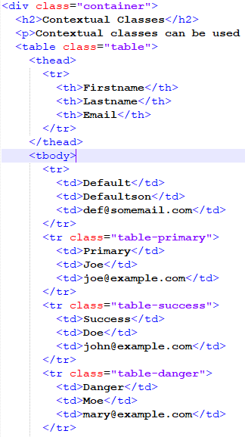
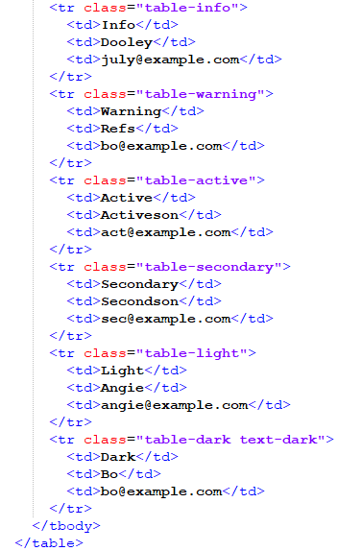
Contextual Classes

Slide 48
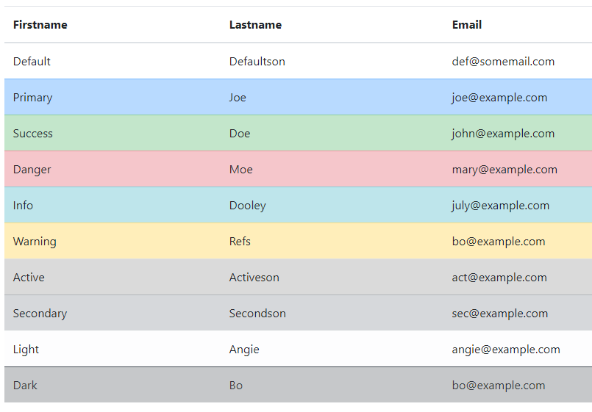
Contextual Classes

Slide 49

Table Head Colors
<thead class="thead-dark">
<thead class="thead-light">

Slide 50
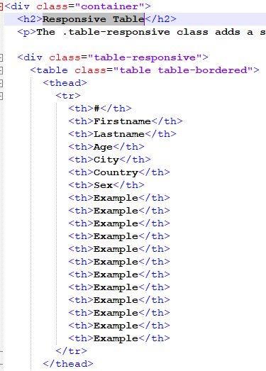
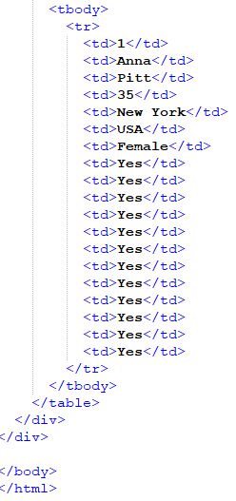
Responsive Table

Slide 51
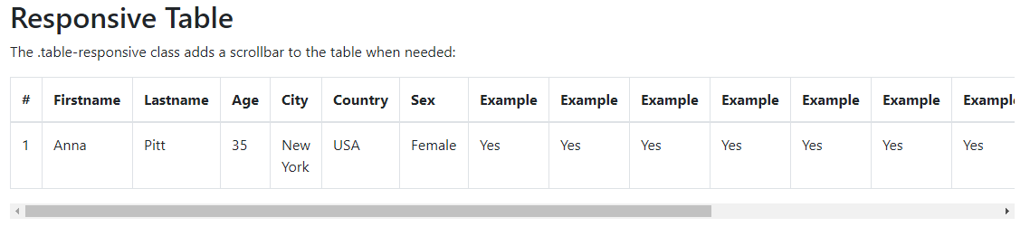
Responsive Table

Slide 52
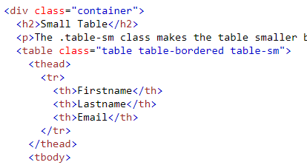
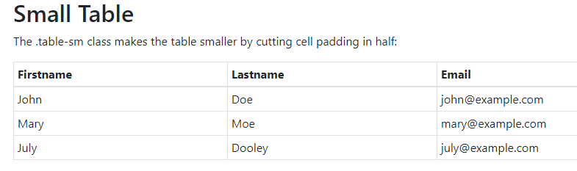
Small Table

Slide 53
Table Responsive
Class | Screen width
.table-responsive-sm | < 576px
.table-responsive-md | < 768px
.table-responsive-lg | < 992px
.table-responsive-xl | < 1200px

Slide 54
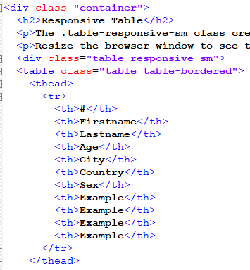
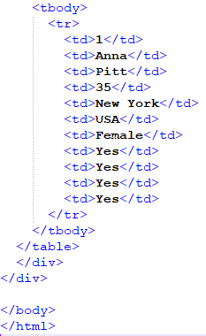
table-responsive-device
<div class="table-responsive-sm">
<table class="table table-bordered">

Slide 55


table-responsive
When Resize

Slide 56

Images
<img src="cinqueterre.jpg" class="rounded" alt="Cinque Terre">
<img src="cinqueterre.jpg" class="rounded-circle” alt="Cinque Terre">
<img src="cinqueterre.jpg" class="img -thumbnail” alt="Cinque Terre">

Slide 57

Aligning Images
Float an image to the right with the .float-right class or to the left with .float-left:
<img src="paris.jpg" class="float-left">
<img src="paris.jpg" class="float-right">

Slide 58

Centered Image
Center an image by adding the utility classes .mx-auto (margin:auto) and .d-block (display:block) to the image:
<img src="paris.jpg" class="mx-auto d-block">

Slide 59


Image

Slide 60


Image

Slide 61

Button Styles

Slide 62


Button

Slide 63


Button Outline

Slide 64

Button Size

Slide 65

Button Size

Slide 66


Active/Disabled Buttons

Slide 67


Spinner Buttons

Slide 68
Button Groups
Bootstrap 4 allows you to group a series of buttons together (on a single line) in a button group
Instead of applying button sizes to every button in a group, use class .btn-group-lg for a large button group or the .btn-group-sm for a small button group

Slide 69


Button Groups

Slide 70


list
Basic List Groups
The most basic list group is an unordered list with list items:

Slide 71


List Group With Badges

Slide 72


List Group With Linked Items

Slide 73


Active State

Slide 74

Horizontal List

Slide 75

Contextual Classes
The classes for coloring list-items are:
list-group-item-success
list-group-item-secondary
list-group-item-info
list-group-item-warning
list-group-item-danger
list-group-item-primary
list-group-item-dark
list-group-item-light

Slide 76

Contextual Classes

Slide 77

Dropdown
A dropdown menu is a toggle able menu that allows the user to choose one value from a predefined list:

Slide 78

Dropdown

Slide 79
Dropdown
The .dropdown class indicates a dropdown menu.
To open the dropdown menu, use a button or a link with a class of .dropdown-toggle and the data-toggle="dropdown" attribute.
The .caret class creates a caret arrow icon ,
Which indicates that the button is a dropdown
Add the .dropdown-menu class to a <ul> element to actually build the dropdown menu.

Slide 80



Dropdown menu & Divider

Slide 81



Dropdown - Divider Header

Slide 82


Drop up & drop right

Slide 83



Dropdown Position

Slide 84


Slide 85


Slide 86

Nav Bar
.navbar
Navbar-default //navbar design
Navbar-inverse
Navbar-nav //for lists inside navbar
navbar-collapse
navbar-fixed-top
navbar-fixed-bottom
navbar-right|left
glyphicon glyphicon-user
glyphicon glyphicon-log-in
data-toggle="dropdown” |"collapse“| “scrollspy”…

Slide 87
Nav Bar
Link elements - 2 data attributes
Data-toggle
Tells bootstrap - What to do
Data-target
Tells bootstrap-which element is going to open
To add links inside the navbar,
use a <ul> element with class="navbar-nav".
Then add <li> elements
class="caret“ – for dropdown symbol to appear

Slide 88
Nav Bar
<nav class="navbar navbar-expand-sm bg-light">
A grey horizontal navbar that becomes vertical on small screens
<nav class="navbar bg-light">
Vertical navigation bar
<nav class="navbar navbar-expand-sm bg-light justify-content-center">
Centered Navbar
.navbar-brand
used to highlight the brand/logo/project name of your page

Slide 89


Slide 90
Nav Bar

Slide 91
Nav Bar

Slide 92
Forms
Form controls automatically receive some global styling with Bootstrap:
All textual <input>, <textarea>, and <select> elements with class .form-control have a width of 100%.

Slide 93
Form Layouts
Bootstrap provides two types of form layouts:
Stacked (full-width) form
Inline form
Add a wrapper element with .form-group, around each form control, to ensure proper margins

Slide 94


Stacked (full-width) form

Slide 95


Inline Form

Slide 96
Input
Bootstrap supports all the HTML5 input types: text, password, datetime, datetime-local, date, month, time, week, number, email, url, search, tel, and color.
Bootstrap supports the following form controls:
input
textarea
checkbox
radio
select

Slide 97
Input Groups
The .input-group class is a container to enhance an input by adding an icon, text or a button in front or behind the input field as a "help text".
Use .input-group-prepend to add the help text in front of the input, and .input-group-append to add it behind the input.
At last, add the .input-group-text class to style the specified help text.

Slide 99
Thank you

